Slide 1

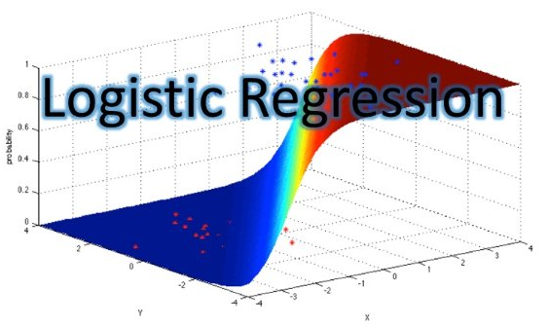
Data Science Logistic Regression
Facultad de Ciencias Económicas
Catedrático: Franz Haidacher

Slide 2
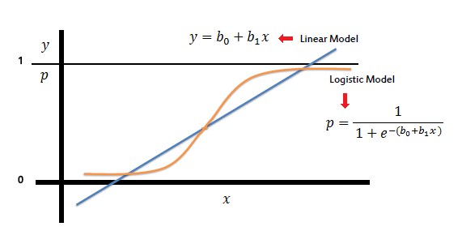
Logistic Regression

Slide 3
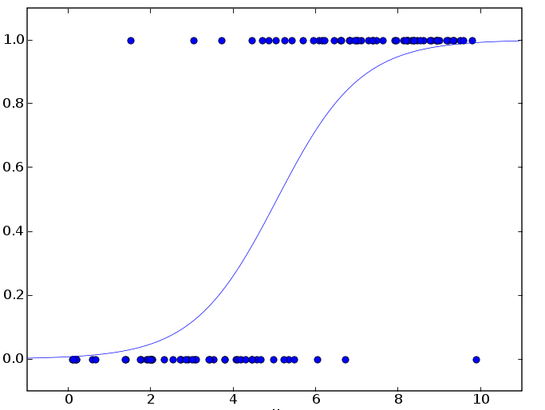
Logistic Regression

Slide 4
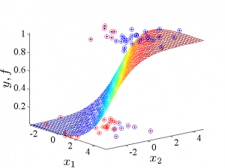
Logistic Regression

